Slide 1


Presentation Topic : Wireless Wide-Area Network (WWAN)
Course Title : Wireless and Mobile Communication
Course Code:ICT-4201
Presented by
Abida Sultana
ID : IT21032
Session:2020-21
Dept of ICT,
MBSTU
Supervised by
Dr. Nazrul Islam
Associate Professor
Dept of ICT,MBSTU

Slide 2
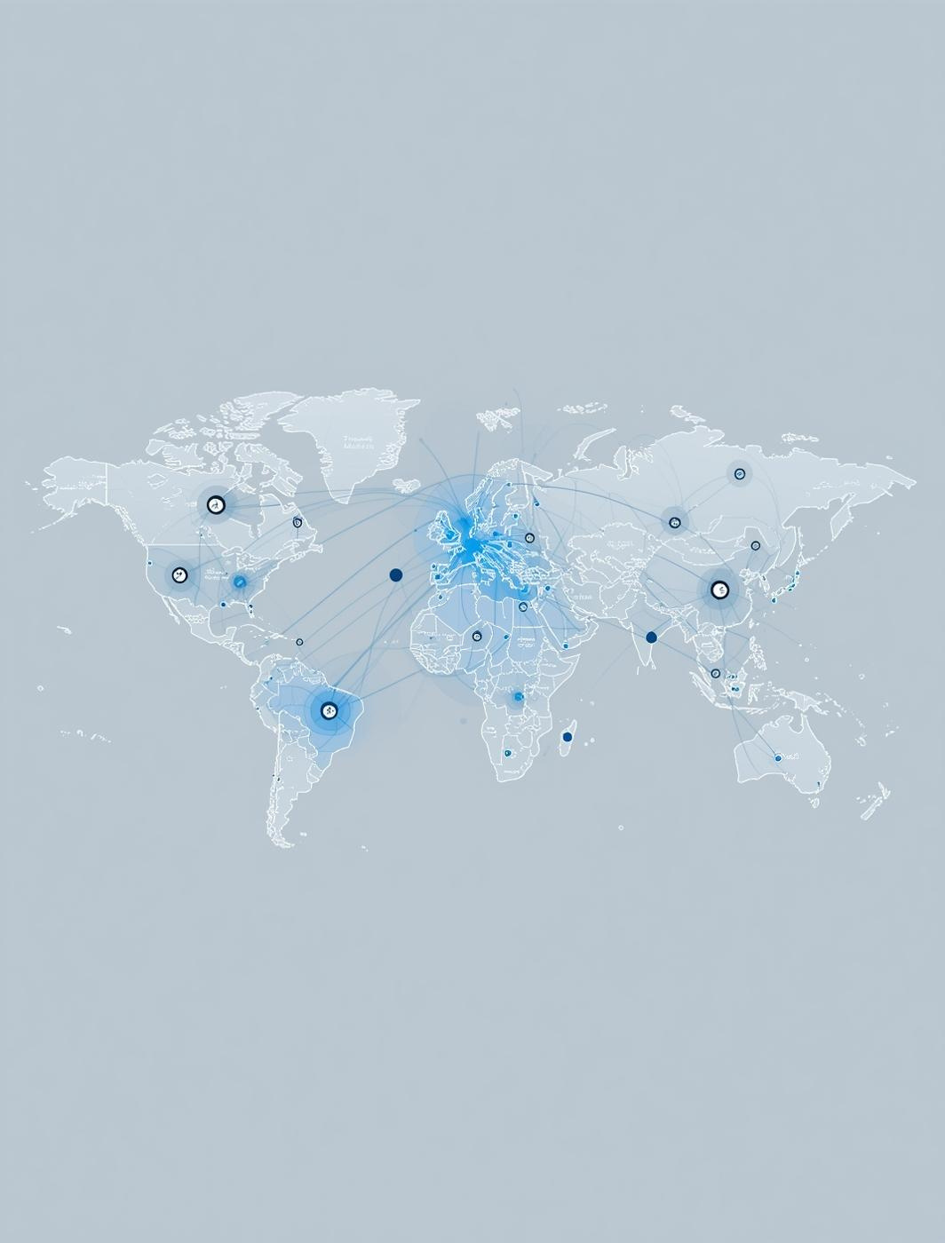
Introduction to WWAN
What is WWAN?
WWAN (Wireless Wide Area Network) is a wireless communication network that provides internet and data connectivity over a large geographical area, such as a city, country, or even globally.
It uses cellular technologies like 3G, 4G, 5G, or satellite communication to connect devices such as smartphones, tablets, and laptops to the internet without needing Wi-Fi or wired connections.
Understanding Wireless Wide-Area Networks and Their Significance.
Wireless Wide-Area Networks (WWAN) are essential for modern communication, enabling connectivity over vast geographical areas, such as countries or globally. Unlike traditional Local Area Networks (LAN) and Wide Area Networks (WAN), WWAN provides mobile support, making it crucial for economic growth and technological advancement in remote and urban areas alike.

Slide 3
Short History of WWAN
1970s–1980s: Early wireless communication and the first analog cellular networks (1G).
1990s: Introduction of digital networks (2G) — enabled SMS and basic data transfer.
2000s: 3G brought faster internet and multimedia services to mobile devices.
2010s: 4G LTE improved data speed, enabling HD streaming and global connectivity.
2020s: 5G revolutionized WWAN with ultra-fast, low-latency connections and IoT support.

Slide 4
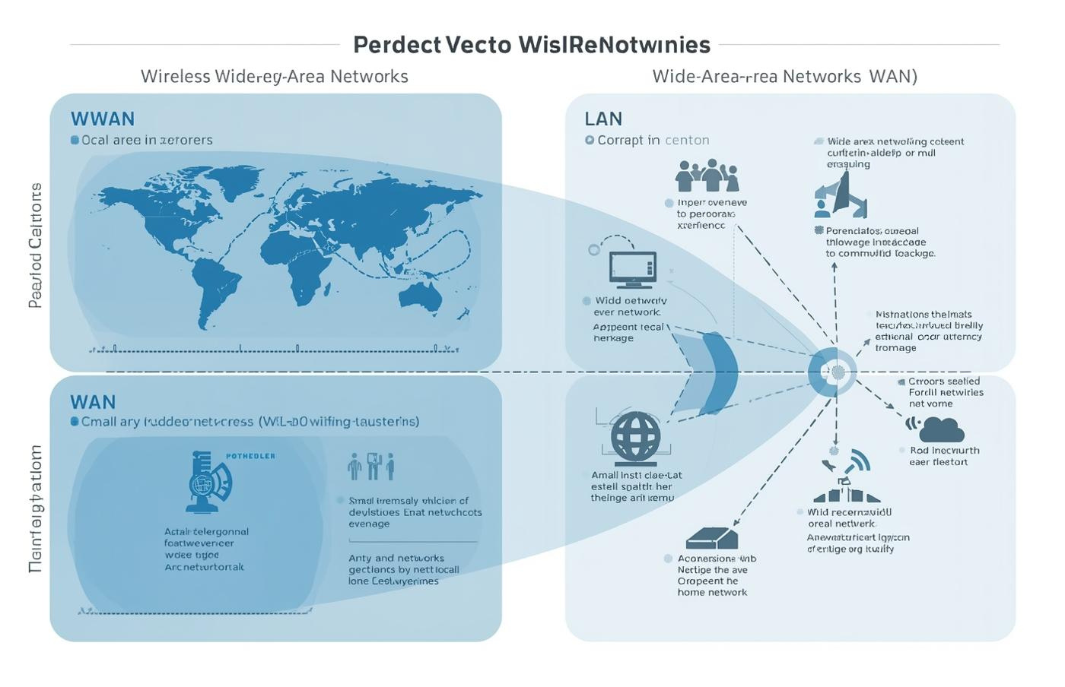
WWAN vs. LAN and WAN

Slide 5
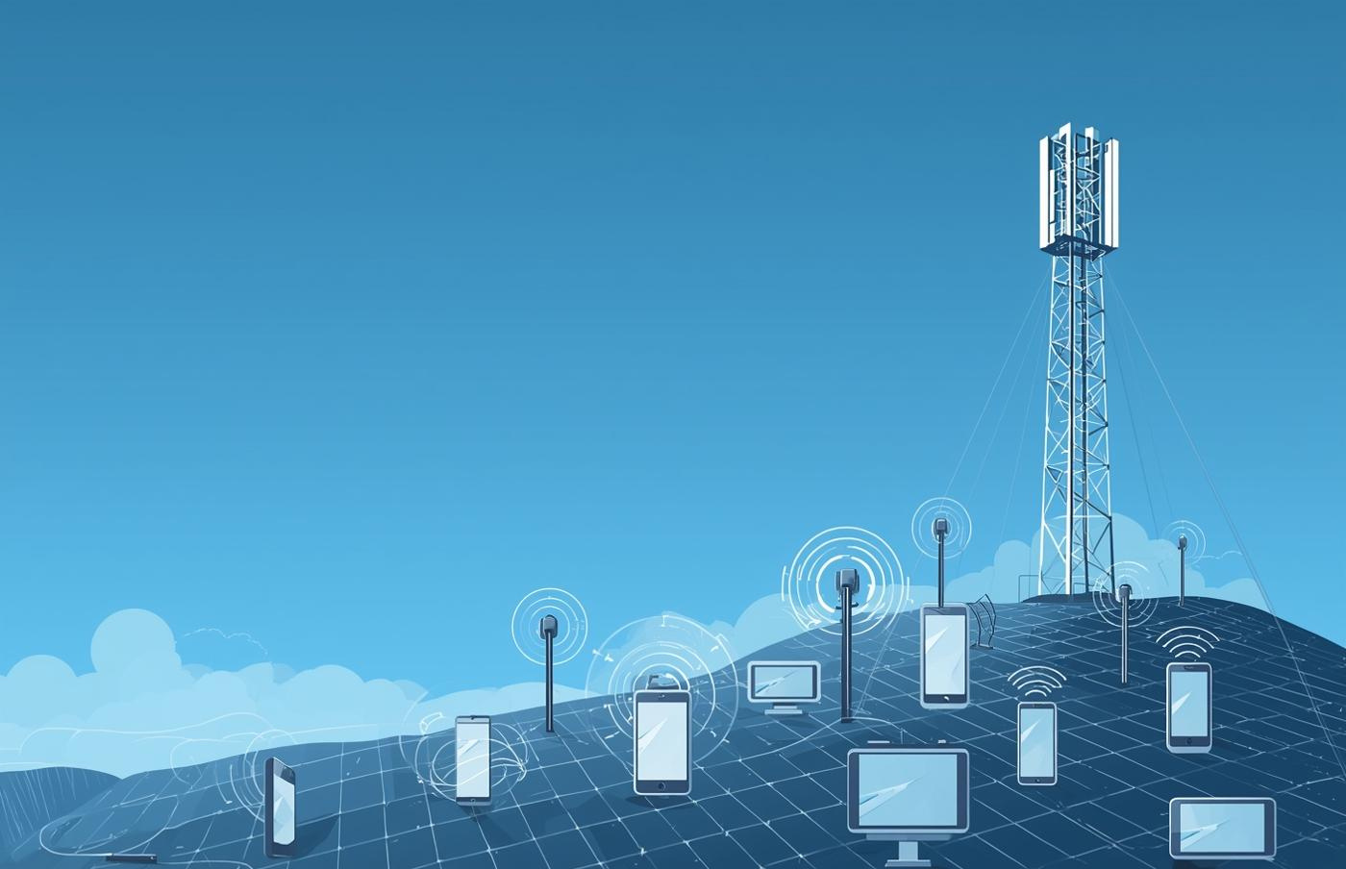
Key Characteristics of WWAN:
Covers a large geographical area (city, country, or global).
Provides wireless communication using cellular or satellite networks.
Offers high mobility — users can stay connected while moving.
Based on cellular technologies like 3G, 4G, and 5G.
Ensures internet access without physical cables.
Managed by telecommunication service providers.
Supports multiple devices (phones, laptops, IoT devices).
Uses encryption and authentication for secure data transfer.
Data speed and reliability depend on signal strength and network type.
.

Slide 6
Applications:
Mobile broadband (4G/5G) services
Satellite communications and telemetry
Vehicle tracking and navigation systems (GPS)
Industrial IoT deployments
Smart city infrastructure
Emergency response and disaster management networks

Slide 7
Advantages:
Extensive coverage: city to global scale
High mobility for users on the move
Supports remote communication and monitoring
Enables advanced applications: IoT, GPS, and emergency systems
Connectivity possible in rural or remote areas via satellite
Disadvantages:
High deployment and operational costs
Lower data rates in weak signal areas
Security vulnerabilities, including interception risks
Susceptible to environmental or atmospheric interference

Slide 8
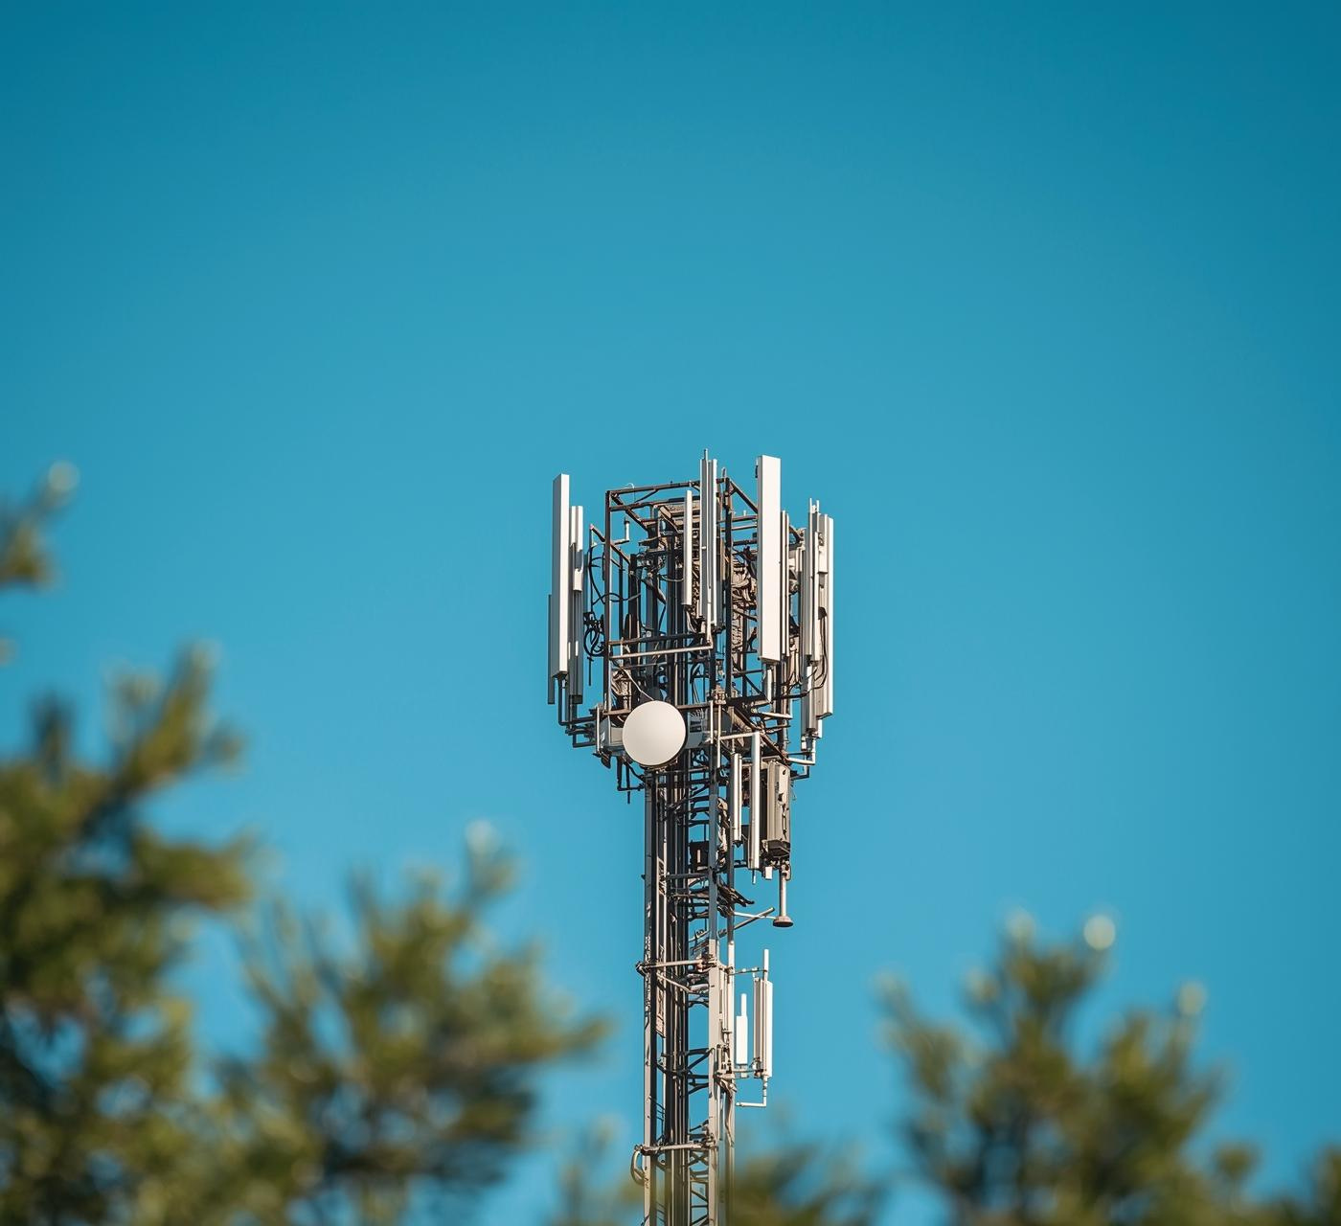
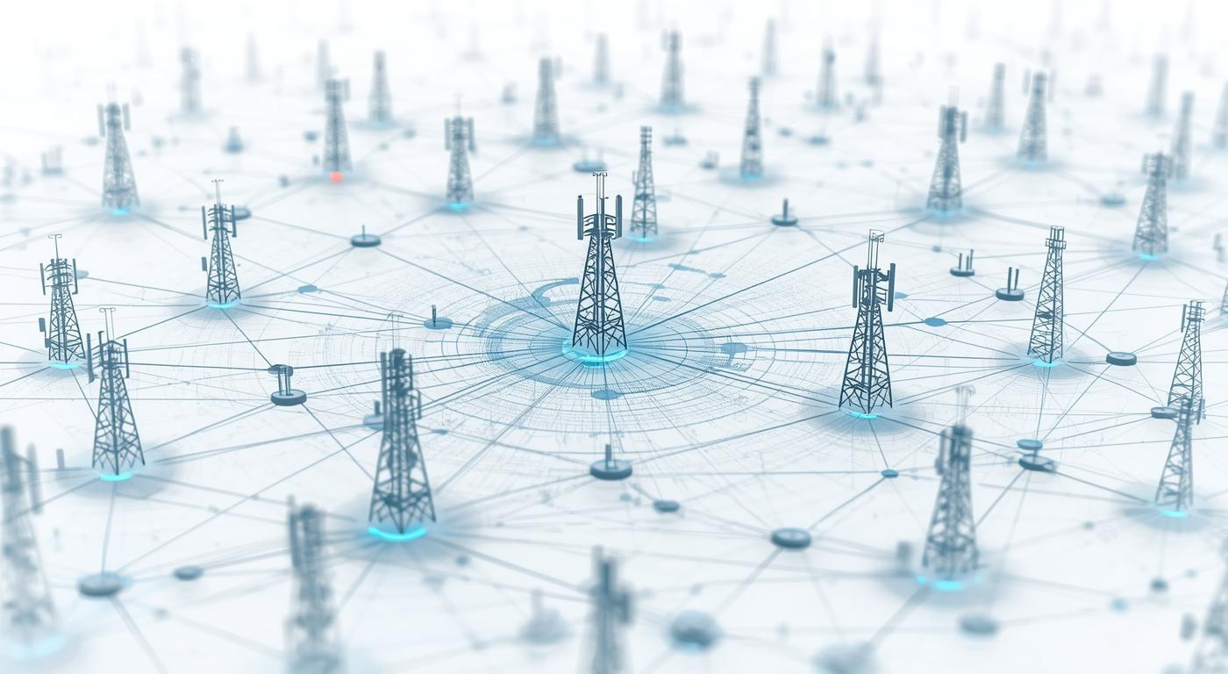
Network Architecture
Cellular Networks
Illustration of modern cellular base stations.
Base Stations
Visual representation of base station technology.

Slide 9
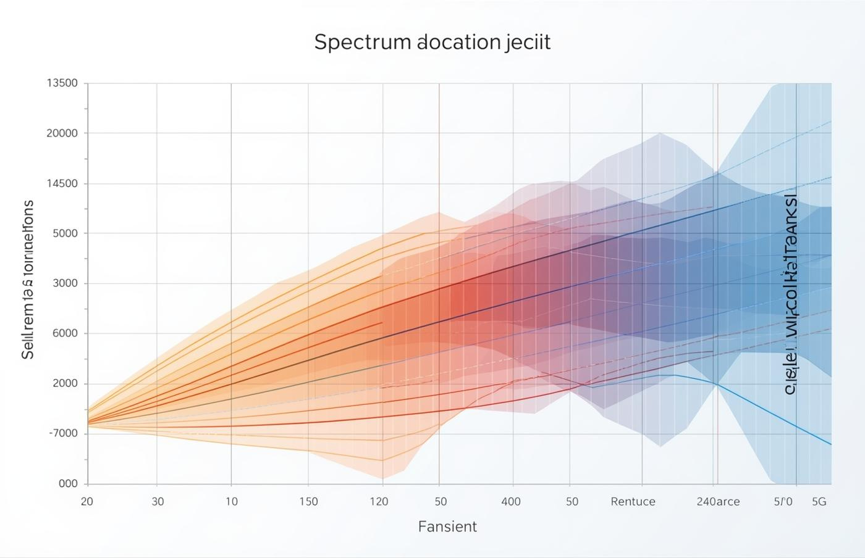
Frequency Bands and Spectrum Usage
Spectrum Allocation
Frequency bands are crucial for WWAN connectivity.

Slide 10
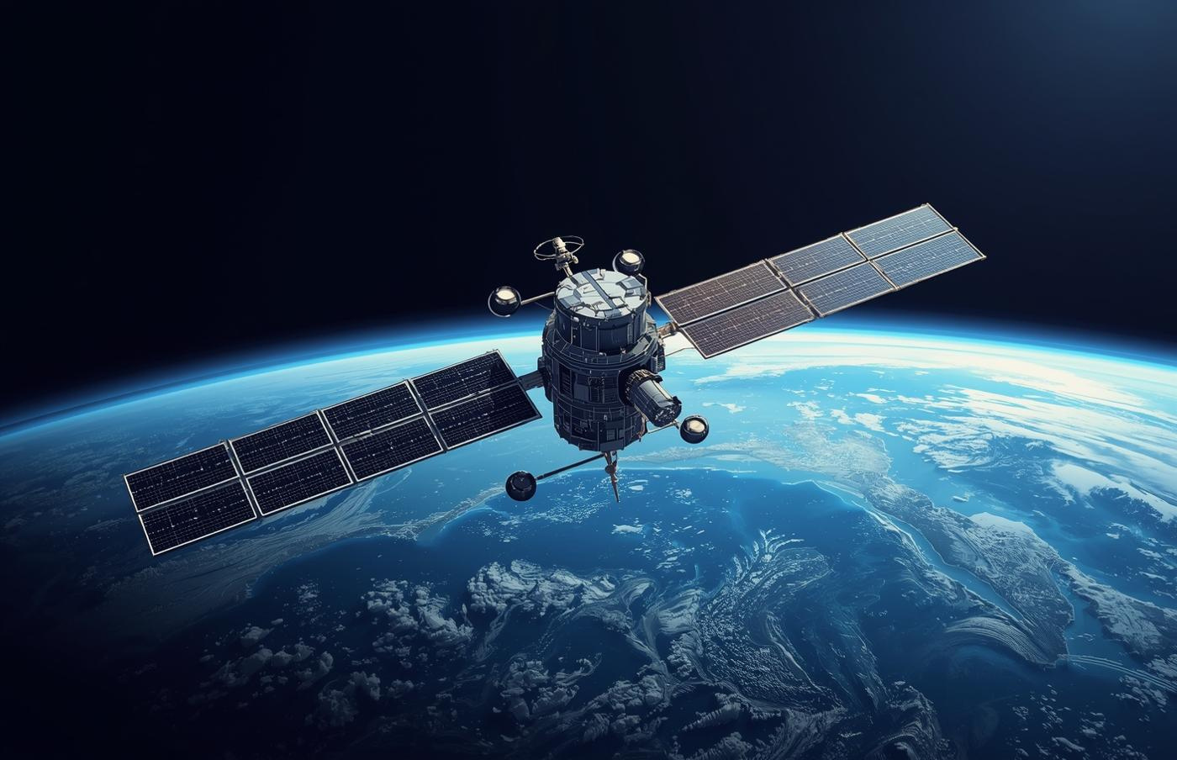
Satellite Communication for Global Connectivity
Global Coverage
Satellites provide essential connectivity across vast distances.

Slide 11
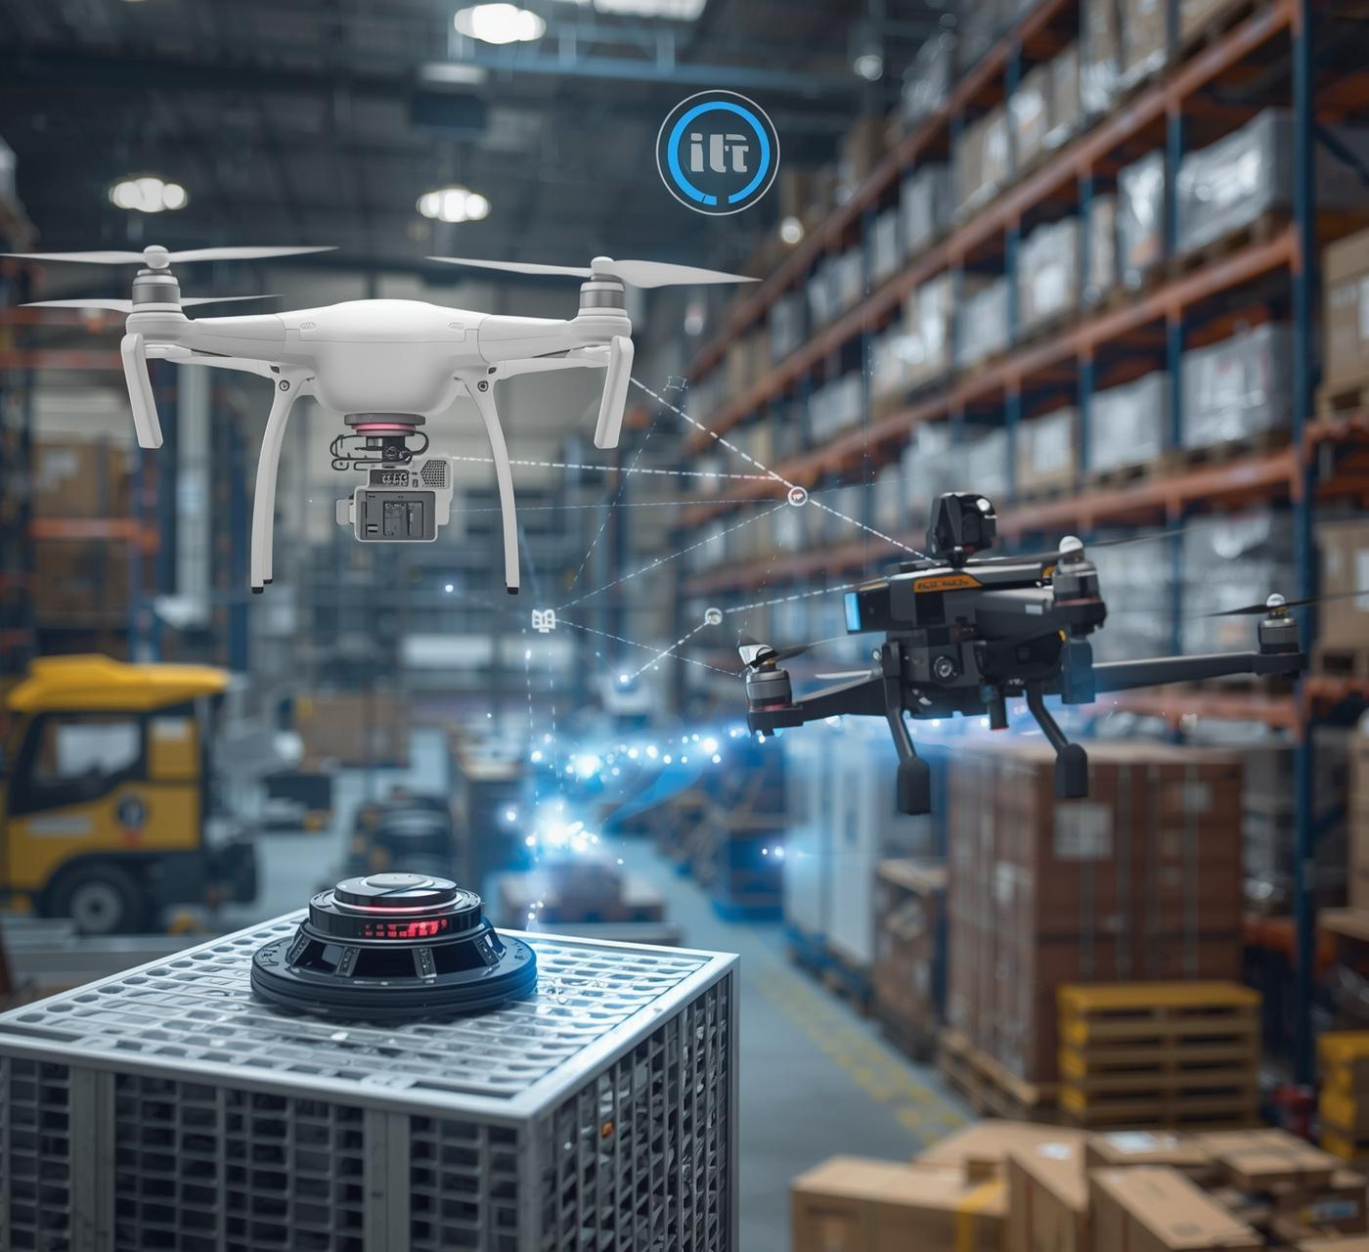
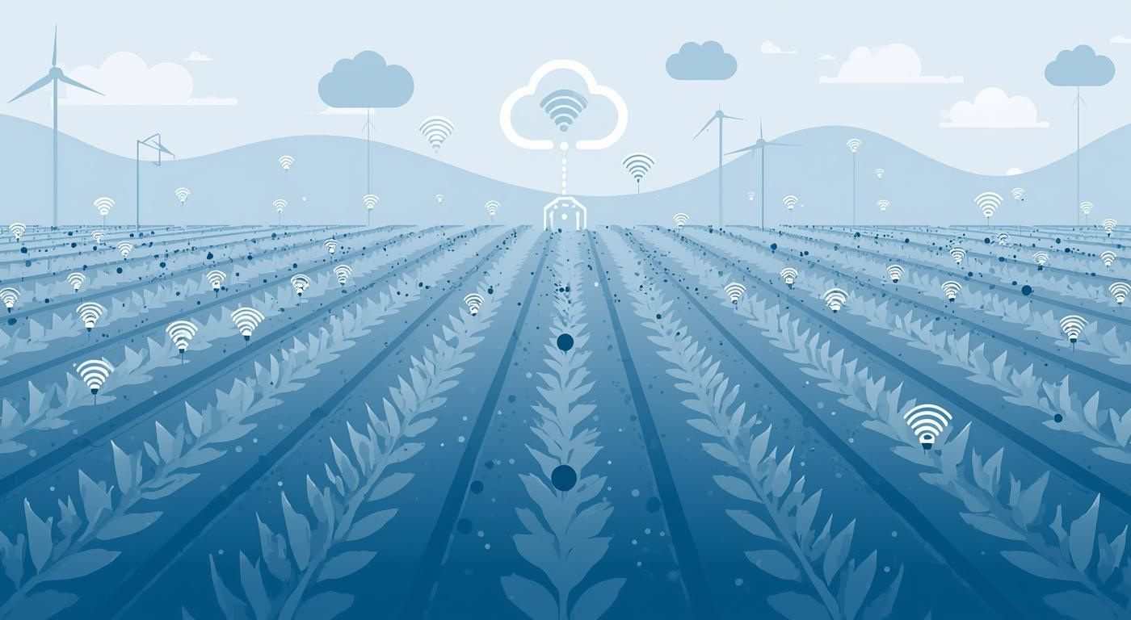
IoT Connectivity
Smart Agriculture
Sensors monitor crops for optimal growth.
Urban Infrastructure
Smart city sensors optimize traffic flow efficiently.

Slide 12
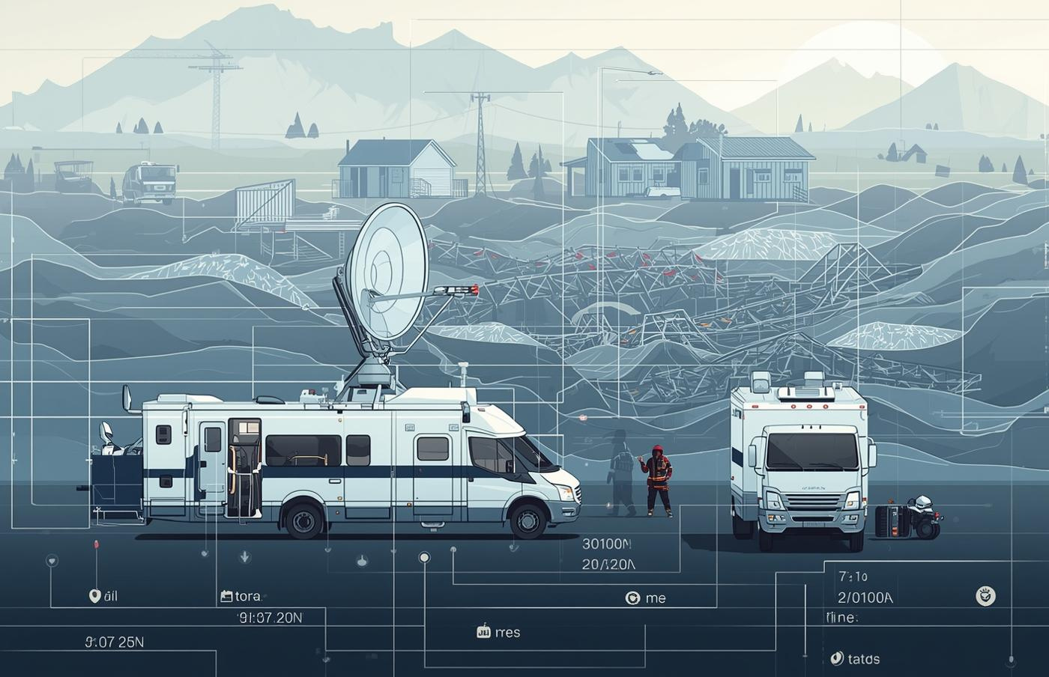
Remote Monitoring and Disaster Management Solutions
Disaster Relief
Effective communication is vital during emergency situations.

Slide 13
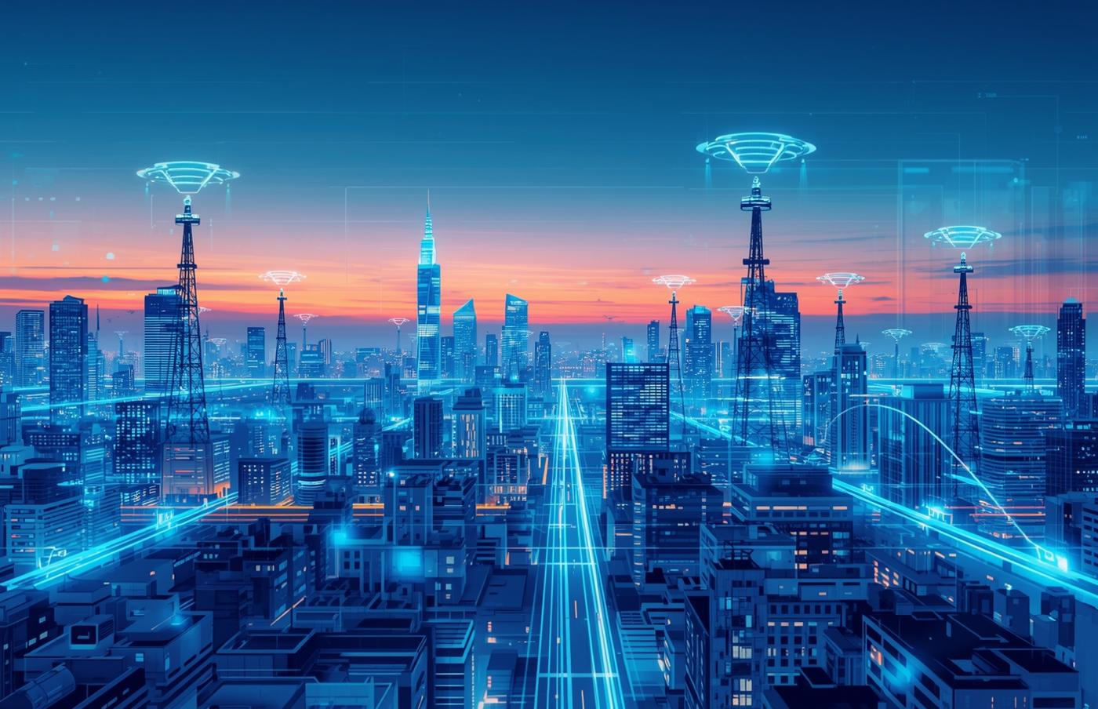
Future of Wireless Networks
Innovations Ahead
5G advancements pave the way for 6G technologies.

Slide 14
Conclusion
Wireless Wide Area Networks (WWANs) provide reliable wireless connectivity over large geographical areas, enabling communication across cities, countries, and even globally. They support mobile devices, IoT applications, GPS, and emergency communication, offering flexibility and scalability. While challenges such as high deployment costs, potential signal limitations, and security concerns exist, WWANs remain a fundamental backbone of modern wireless communication. Future developments, including 5G, 6G, and satellite-based networks, are expected to further enhance speed, coverage, and connectivity reliability worldwide.

Slide 15


